Slide 1
What's changed from CRM 4.0 to CRM 2011
From a Developers Point of View

Slide 2
Mitch Milam
mitch@xrmcoaches.com
@mitchmilam
Blogs.infinite-x.net
Xrmcoaches.com
Crmaccelerators.net

Slide 3
Overview
Discuss changes to:
JavaScript object model
.NET development using the CRM SDK

Slide 4
JavaScript

Slide 5
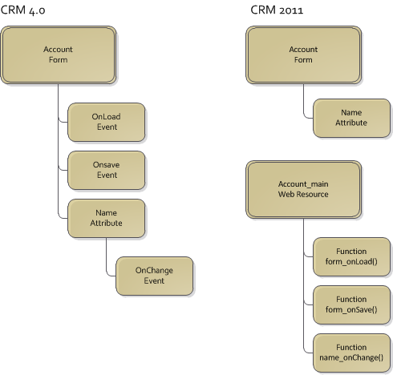
JavaScript Storage

Slide 6
JavaScript Storage
JavaScript is stored in Web Resources
Web Resources are linked to Events
Events linked to individual functions

Slide 7
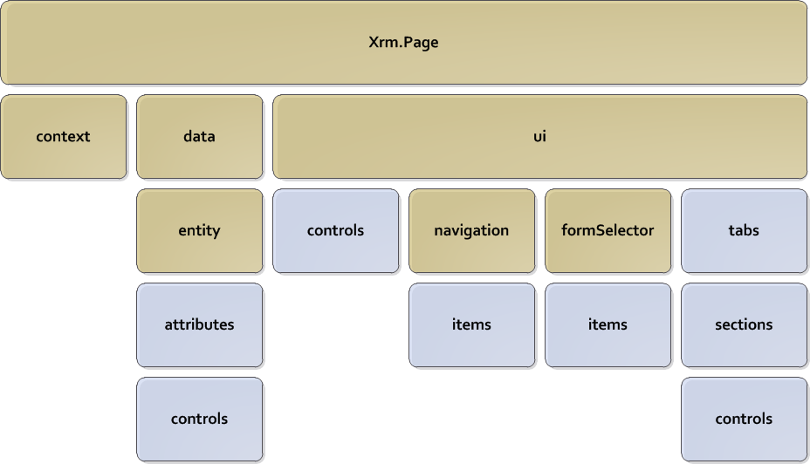
CRM 2011 Object Model

Slide 8
JavaScript Syntax Example
CRM 4.0
crmForm.all.name.DataValue = “Contoso”;
var name = crmForm.all.name.DataValue;
CRM 2011
Xrm.Page.getAttribute(“name”).setValue(“Contoso”);
var name = Xrm.Page.getAttribute(“name”).getValue();

Slide 9
Xrm.Page
Xrm.Page.context
Xrm.Page.data.entity
Xrm.Page.ui
Shortcuts
Xrm.Page.getAttribute
Xrm.Page.getControl

Slide 10
Xrm.Page.ui
close
getCurrentControl
getFormType
getViewPortHeight
getViewPortWidth
refreshRibbon

Slide 11
Xrm.Page.data.entity
addOnSave
getDataXml
getEntityName
getId
getIsDirty
removeOnSave
save

Slide 12
Context Methods
Xrm.Page.context
getAuthenticationHeader
getOrgUniqueName
getQueryStringParameters
getServerUrl
getUserId
getUserRoles

Slide 13
Attribute Methods
Xrm.Page.getAttribute
getValue
setValue
getSubmitMode
setSubmitMode
fireOnChange
getRequiredLevel
setRequiredLevel

Slide 14
Control Methods
Xrm.Page.getControl
setDisabled
setLabel
setVisible
setFocus
getSrc
setSrc

Slide 15
Tab Methods
Xrm.Page.ui.tabs.get()
getDisplayState
setDisplayState
getVisible
setVisible
setFocus
getLabel
setLabel

Slide 16
Section Methods
Xrm.Page.ui.tabs(0).sections.get
getVisible
setVisible
getLabel
setLabel
getParent
getName

Slide 17
Navigation Methods
Xrm.Page.ui.navigation.items.get
getId
getVisible
setVisible
getLabel
setLabel
setFocus

Slide 18
Q: What’s the Main Difference?
Who can tell me what the main difference between CRM 4.0 JavaScript and CRM 2011 JavaScript?

Slide 19
A: What’s the Main Difference?
Many of the ‘unsupported’ tasks performed in CRM 4.0 are now officially supported.

Slide 20
JavaScript Events
Event Name | Description
OnLoad | Occurs after the form has loaded.
OnSave | Occurs when a user presses the Save, Save and Close, or Save and New button on the form.
OnChange | Occurs when the data in a form field has changed and focus is lost.
TabStateChange | Occurs when the DisplayState of the tab changes due to user interaction or when the setDisplayState method is applied in code. Use this event when you wish to change the src property of an IFRAME within the tab
OnReadyStateComplete | Indicates that the content of the IFRAME has loaded and can be accessed in code.

Slide 21
Form Event Handler Execution Context
getContext
getDepth
getEventSource
getSharedVariable
setSharedVariable

Slide 22
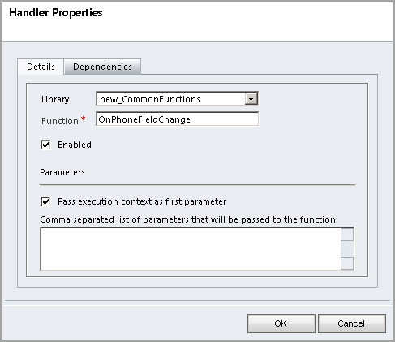
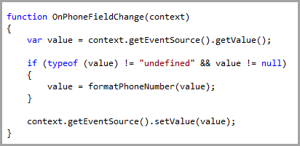
Form Event Handler Execution Context Usage

Slide 23
Questions?

Slide 24
.NET Development

Slide 25
Assemblies
CRM 4.0
microsoft.crm.sdk.dll
microsoft.crm.sdktypeproxy.dll
CRM 2011
Microsoft.Crm.Sdk.Proxy.dll
Microsoft.Xrm.Sdk.dll
Microsoft.Xrm.Sdk.Workflow.dll

Slide 26
Web Services
CRM 4.0
CrmService
MetadataService
CrmDiscoveryService
CRM 2011
IDiscoveryService
IOrganizationService

Slide 27
Code Generation
CrmSvcUtil
Generates early-bound classes for an organization
Default organization code:
sdk\samplecode\cs\helpercode\myorganizationcrmsdktypes.cs

Slide 28
Entity Classes
CRM 4.0
BusinessEntity
DynamicEntity
Account
CRM 2011
Entity

Slide 29
Early-Bound Classes
Produced by CrmSvcUtil
Compile-time checking
Intellisense
Usage:
Account account = new Account()
account.name = “Contoso”;

Slide 30
Late-Bound Classes
Slightly faster than early-bound
Runtime checking
No Intellisense
Usage
Entity account = new Entity(Account.EntityLogicalName);
account[“name”] = “contoso”;

Slide 31
Mixed Early-Bound and Late-Bound
Account account = new Account()
account.name = “Contoso”;
account[“accountnumber”] = GetNewAccountNumber();

Slide 32
Data Types
CRM 2011 uses standard .NET data types
Special types:
EntityReference
Money
OptionSetValue

Slide 33
Exceptions
CRM 4.0
SoapException
CRM 2011
OrganizationServiceFault
DiscoveryServiceFault

Slide 34
Plug-Ins: Execute Method
CRM 4.0
public void Execute(IPluginExecutionContext context)
CRM 2011
public void Execute(IServiceProvider serviceProvider)

Slide 35
Plug-Ins: CRM 2011 Additional Code
// Obtain the execution context from the service provider.
IPluginExecutionContext context = (IPluginExecutionContext)serviceProvider.GetService(typeof(IPluginExecutionContext));
// Get a reference to the organization service.
IOrganizationServiceFactory factory = (IOrganizationServiceFactory)serviceProvider.GetService(typeof(IOrganizationServiceFactory));
IOrganizationService service = factory.CreateOrganizationService(context.UserId);
// Get a reference to the tracing service.
ITracingService tracingService = (ITracingService)serviceProvider.GetService(typeof(ITracingService));

Slide 36
Plug-ins: Notes
Tracing Service is built-in
Only records trace data upon plugin failure
Exceptions
InvalidPluginExecutionException
Will show error within the CRM user interface

Slide 37
Workflow Activities: References
CRM 4.0
using System.Workflow.Activities;
using System.Workflow.ComponentModel;
using System.Workflow.ComponentModel.Compiler;
using Microsoft.Crm.Sdk;
using Microsoft.Crm.Sdk.Query;
using Microsoft.Crm.SdkTypeProxy;
using Microsoft.Crm.Workflow;
CRM 2011
using System.Activities;
using Microsoft.Crm.Sdk.Messages;
using Microsoft.Xrm.Sdk;
using Microsoft.Xrm.Sdk.Workflow;

Slide 38
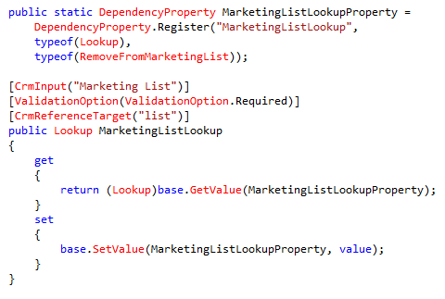
Workflow Activities: Parameters
CRM 4.0

Slide 39

Workflow Activities: Parameters
CRM 2011

Slide 40
Workflow Activities: Class Definition
CRM 4.0
[CrmWorkflowActivity("Remove from Marketing List", "CRM Accelerators")]
public class RemoveFromMarketingList: SequenceActivity
CRM 2011
public class AddToMarketingList : CodeActivity

Slide 41
Workflow Activities: Execute Method
CRM 4.0
protected override ActivityExecutionStatus Execute(ActivityExecutionContext executionContext)
CRM 2011
protected override void Execute(CodeActivityContext executionContext)

Slide 42
Workflow Activities: Connecting to CRM
CRM 4.0
IContextService contextService = (IContextService)executionContext.GetService(typeof(IContextService));
IWorkflowContext context = contextService.Context;
ICrmService crmService = context.CreateCrmService();

Slide 43
Workflow Activities: Connecting to CRM
CRM 2011
IWorkflowContext context = executionContext.GetExtension<IWorkflowContext>();
IOrganizationServiceFactory serviceFactory = executionContext.GetExtension<IOrganizationServiceFactory>();
IOrganizationService service = serviceFactory.CreateOrganizationService(context.UserId);

Slide 44
Workflow Activities: Parameters
CRM 4.0
Guid ListId = MarketingListLookup.Value;
CRM 2011
Guid ListId = MarketingListEntityReference.Get<EntityReference>(executionContext).Id;

Slide 45
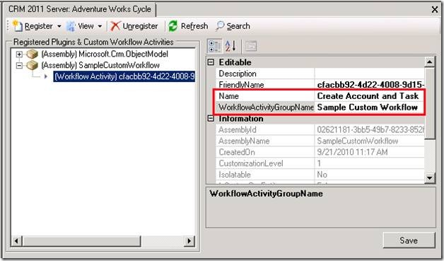
Workflow Activities: Registration

Slide 46
Questions?

